Slide 1
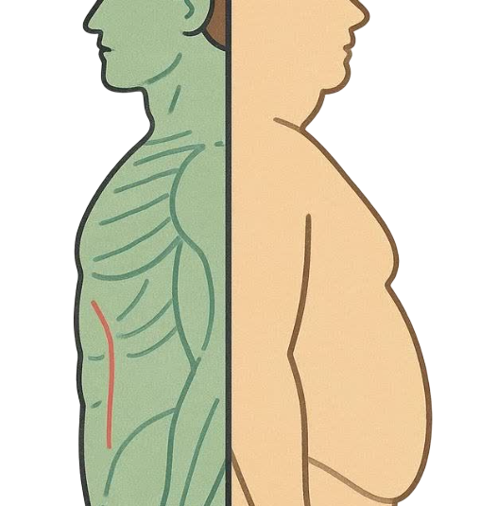
Predicting Body Fat %
Group 2: Clea Yenifer, Sutolimin Widjaja, Vincent Lavoie, Yuchi Yu

Slide 2
Calculate Body Fat % using simple body measurements
02
OUR OBJECTIVE:
A simple, practical model that anyone can use - without sacrificing predictive power.

Slide 3
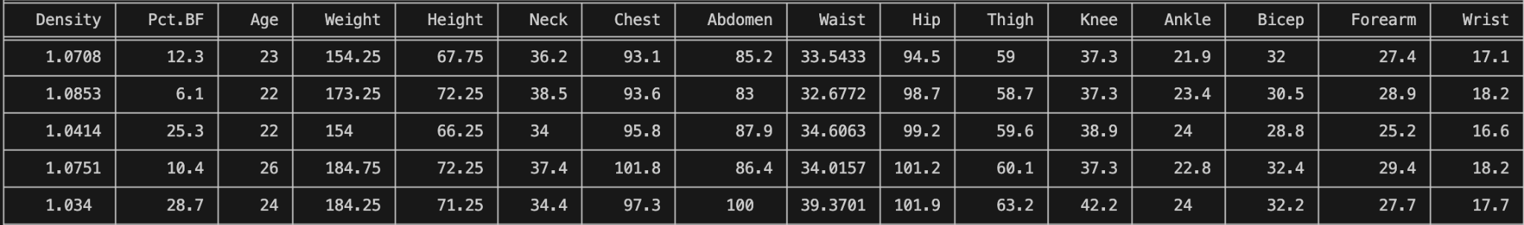
Dataset
03

Slide 4
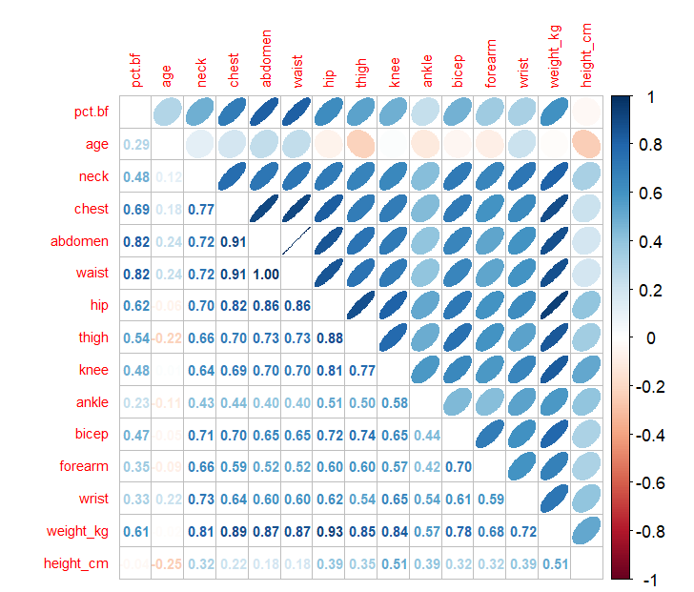
EDA
04

Slide 5
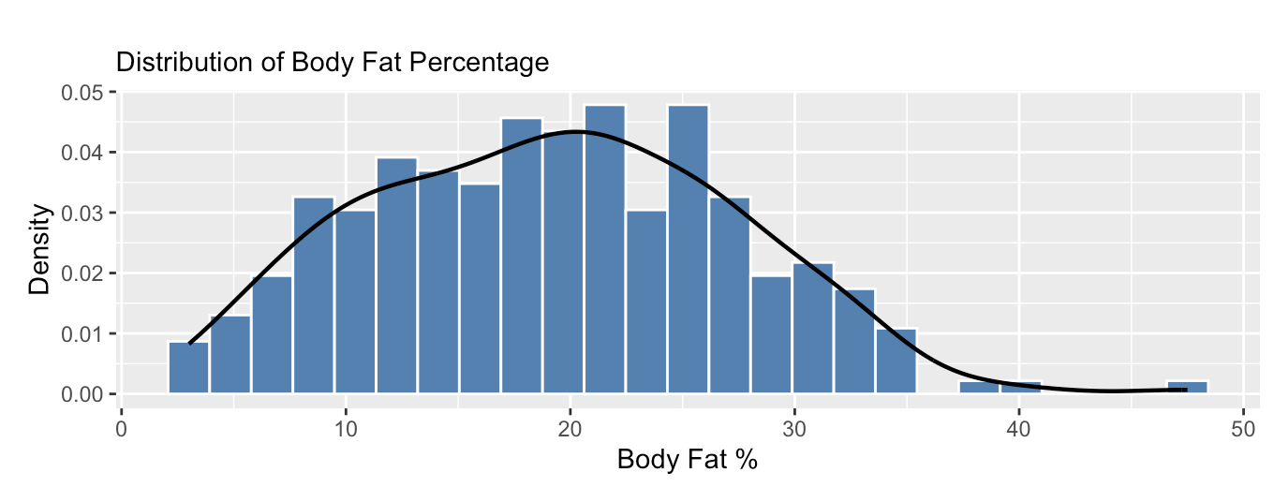
EDA
05

Slide 6
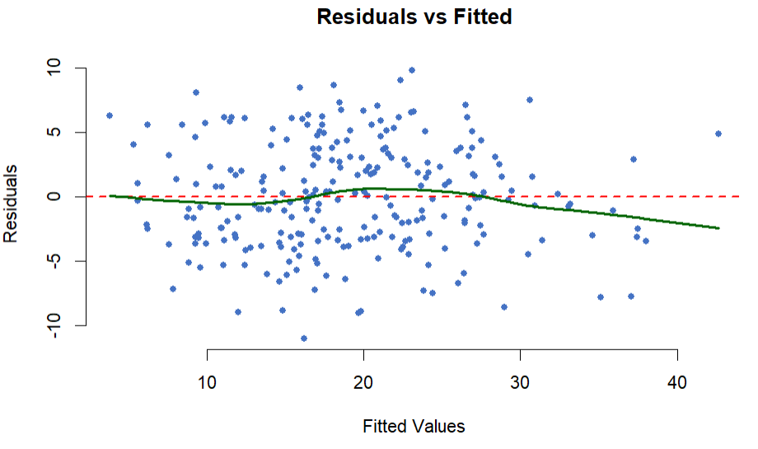
Model Experimentation
06
Body Fat % ~ age + neck + chest + abdomen + hip + thigh + knee + ankle + bicep + forearm + wrist + height_cm + weight_kg

Slide 7
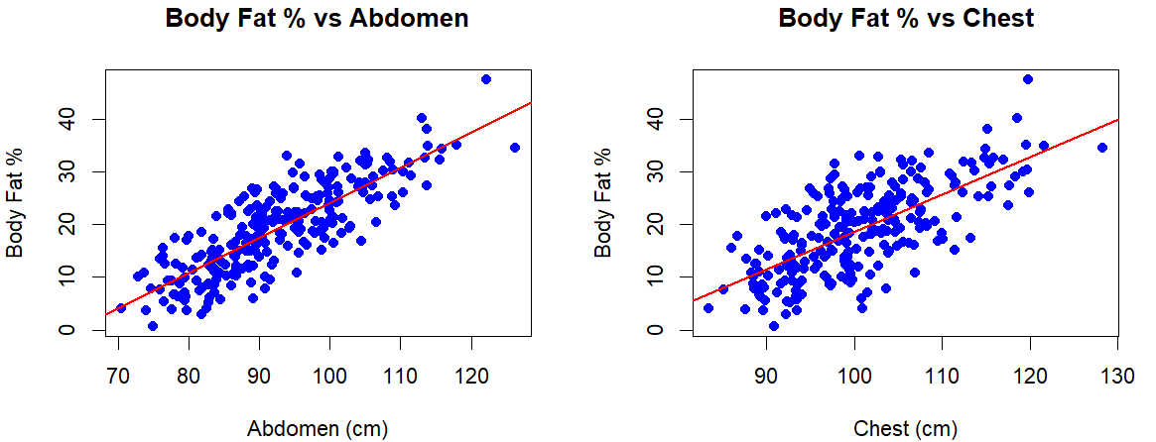
Model Experimentation
07

Slide 8
Model Experimentation
VIF (Variance Inflation Factor)
age | neck | chest | abdomen | hip | thigh | knee | ankle | bicep
2.28 | 3.93 | 10.63 | 11.73 | 11.9 | 7.08 | 4.36 | 1.79 | 3.39
bicep | forearm | wrist | weight_kg | height_cm
3.39 | 2.39 | 3.22 | 44.98 | 3.46
Body Fat % ~ age + abdomen + wrist + height_cm

Slide 9
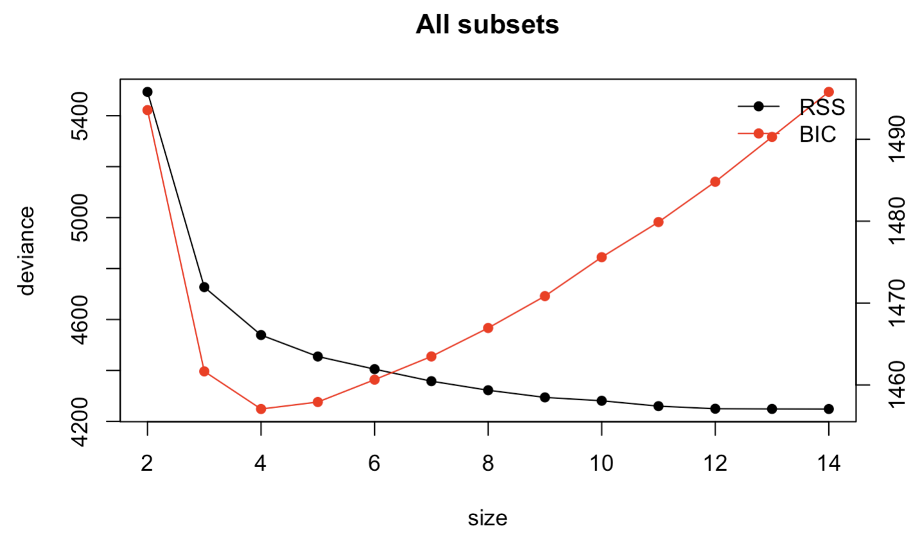
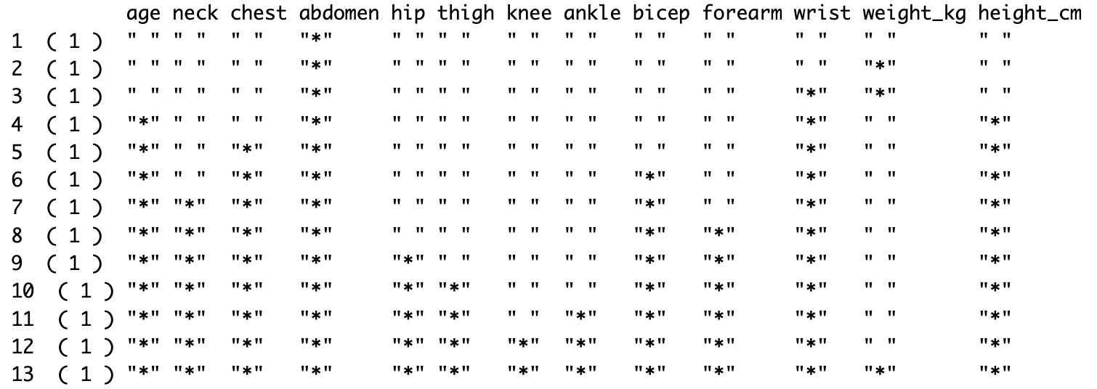
Model Comparisons
1) Exhaustive Search

Slide 10
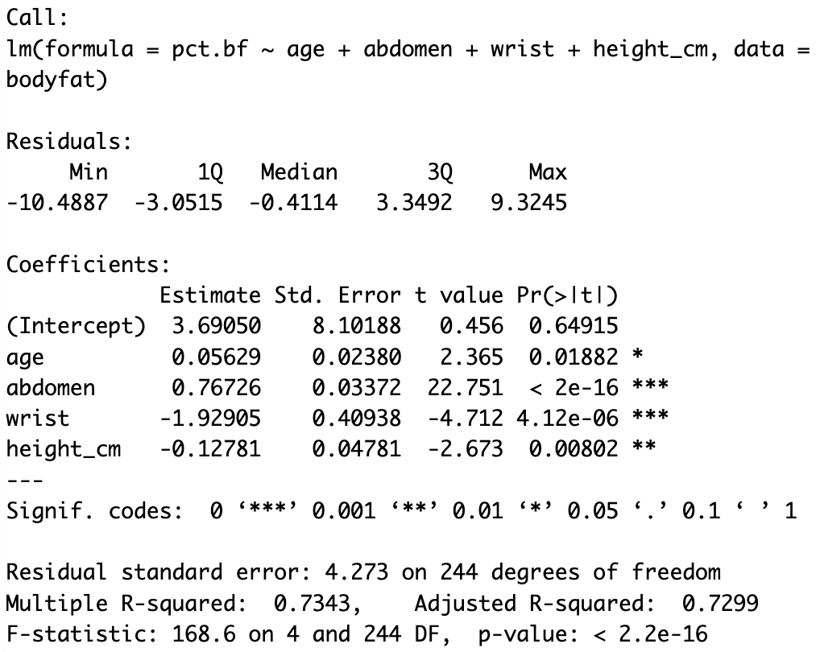
Model Comparisons
1) Exhaustive Search
Body fat =
3.69+ 0.056age+0.76abdomen-1.929wrist-0.128height
P-value <0.05 => βi≠0

Slide 11
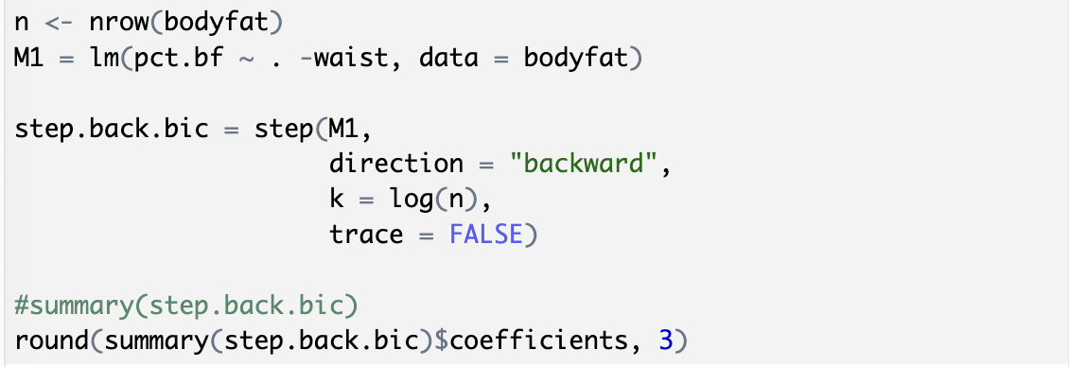
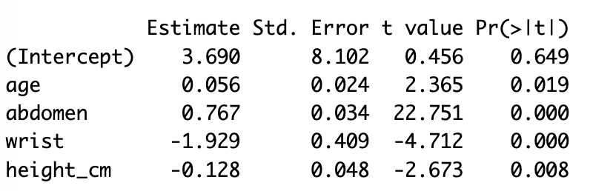
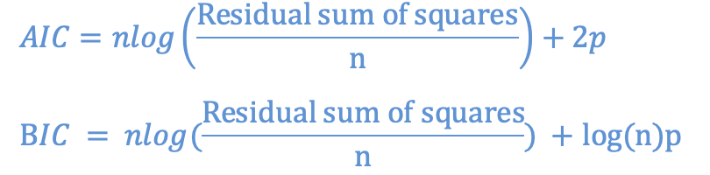
Model Comparisons
2) Backward variable selection
P-value < 0.05
BIC vs. AIC: Using log(n) makes the model "stricter" than the standard AIC.
It prefers a simpler model with fewer variables to avoid overfitting.

Slide 12
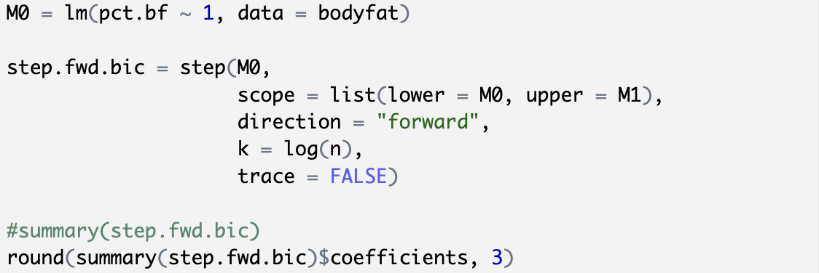
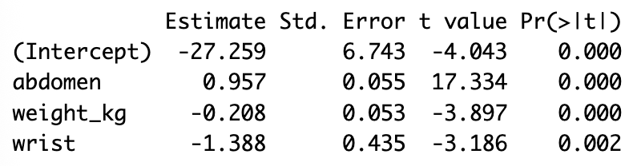
Model Comparisons
3) Forward variable selection
P-value < 0.05
Exhaustive research is better than Backward/forward variable selection

Slide 13
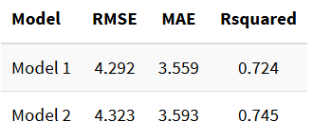
Cross Validation
Model 1: Body Fat % ~ age + abdomen + wrist + height_cm
Model 2: Body Fat % ~ abdomen + weight_kg + wrist
We choose Model 1 given the smaller errors, despite the lower R²

Slide 14
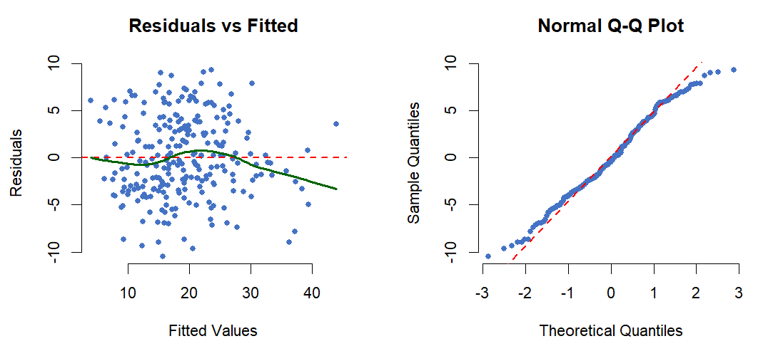
Assumptions Checking
Linearity, Normality
Overestimating the body fat percentage

Slide 15
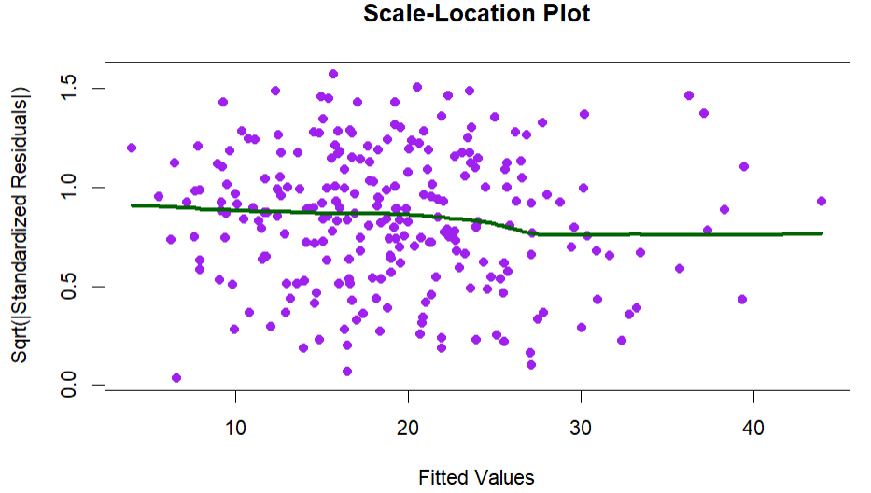
Assumptions Checking
Independence, Homoskedasticity

Slide 16
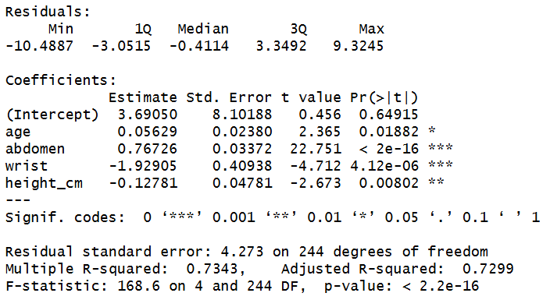
Final Model
Body Fat % ~ age + abdomen + wrist + height_cm

Slide 17
Limitations
01
02
Model predicts only male adults
Relatively small sample size
03
04
Measurement errors in the outcome
Tape measurement errors

Slide 18
Thanks!

Slide 19
Any Questions ?

